Slide 1
New Voices. New Voters. New Mexico.

Slide 2
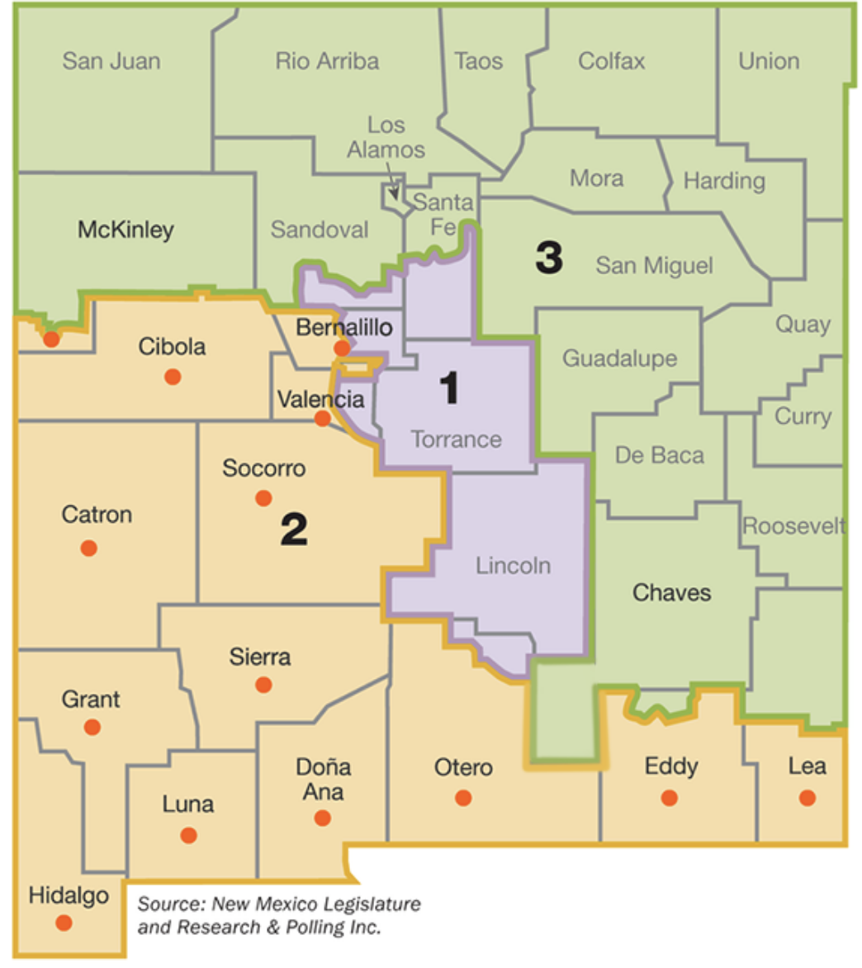
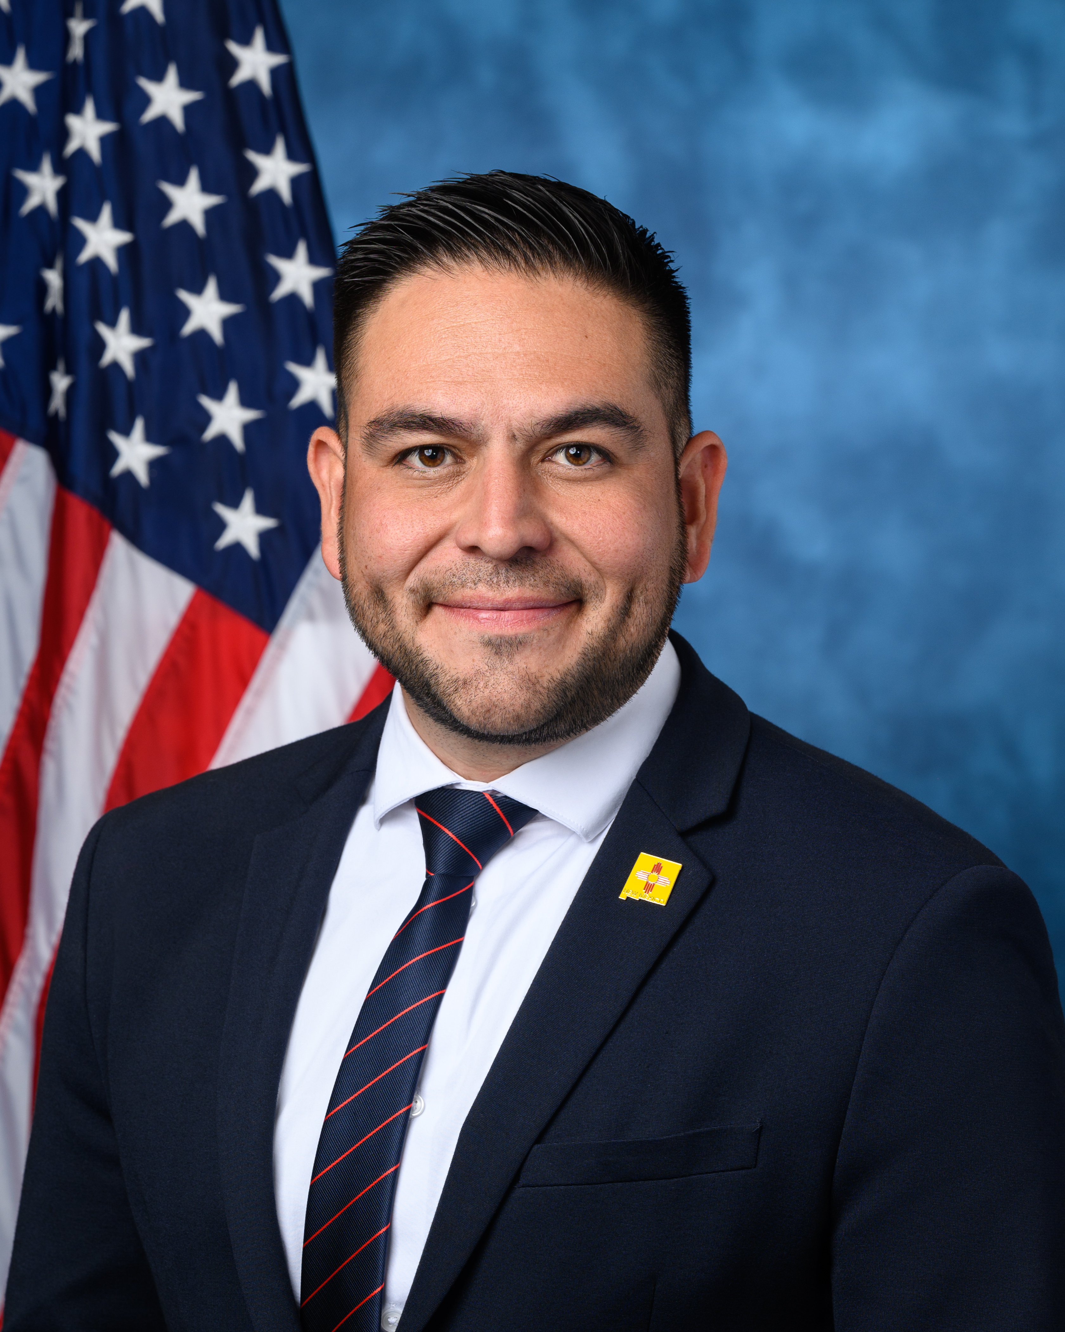
Rep. Gabe Vasquez represents New Mexico’s 2nd Congressional District
Let’s look at his record.

Slide 3
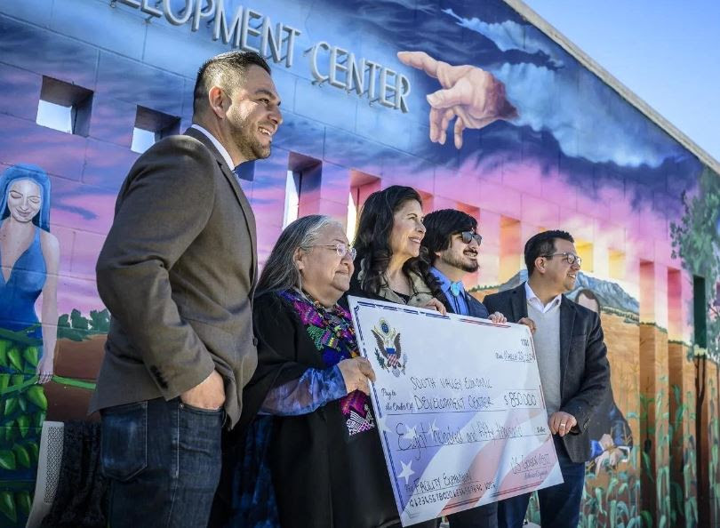
Vasquez Secured Funding for these Community Projects*
South Valley Economic Development Center Expansion Project in Albuquerque
$850,000 for the construction
of an agricultural economic development center to help increase job growth in this sector.
*When she represented the district (2020-2022), Yvette Herrell did not secure funding for any Community Project.

Slide 4
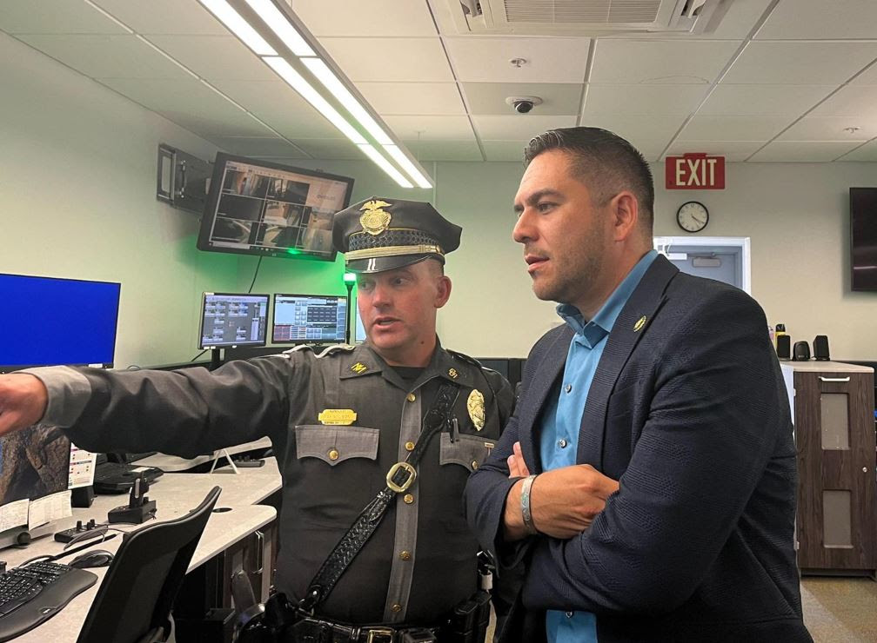
Vasquez Secured Funding for
NM Dept. of Public Safety’s Communication Improvement Project
Across N.M.
$800,000 for the acquisition
of handheld radios and
satellite communication technology to help improve
law enforcement
communication in rural communities.

Slide 5
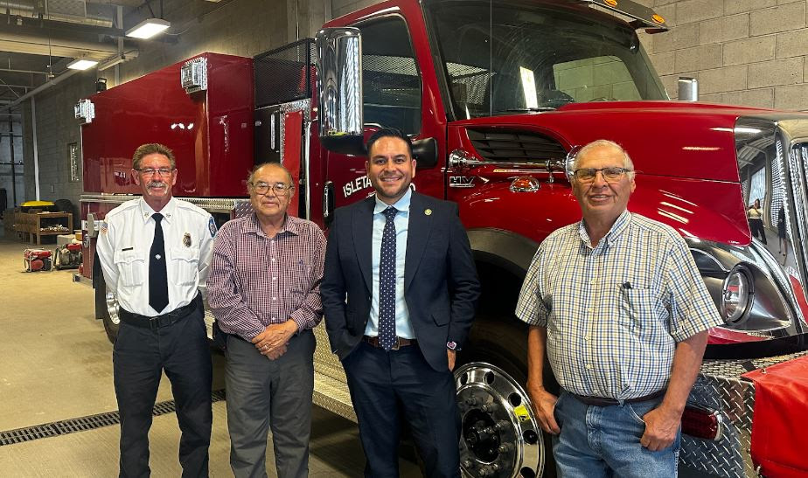
Vasquez Secured Funding for
Fire Protection Vehicle Acquisition Project in Isleta Pueblo
$900,000 to acquire a new fire protection vehicle for the Pueblo of Isleta, to protect the community from wildfires and other fires.

Slide 6
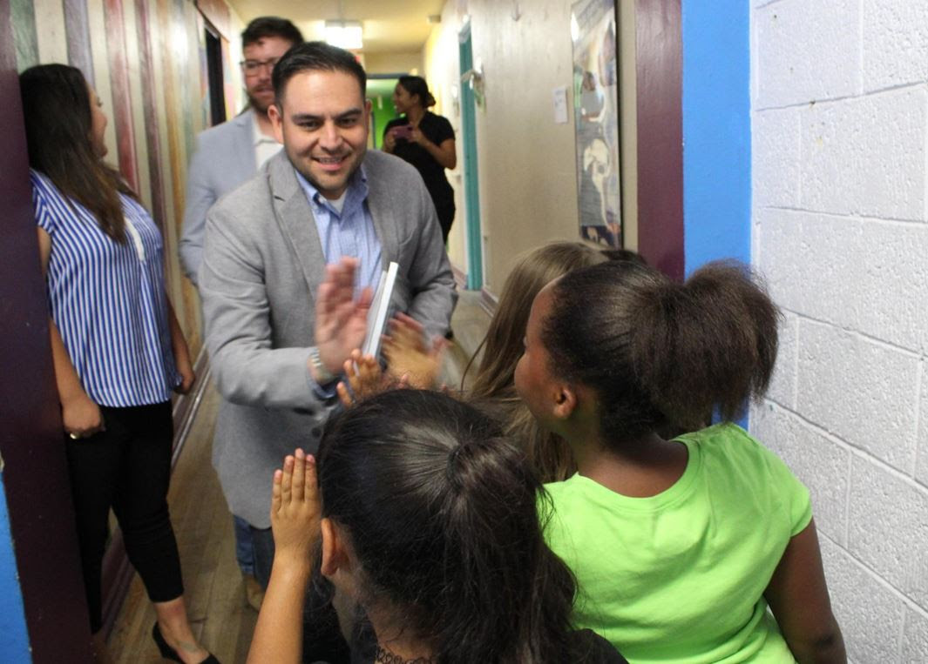
Vasquez Secured Funding for
Boys and Girls Club of Las Cruces
Renovation Project
$1,466,279 for the renovation of a facility that will include space for after-school activities, learning, and other programming.

Slide 7
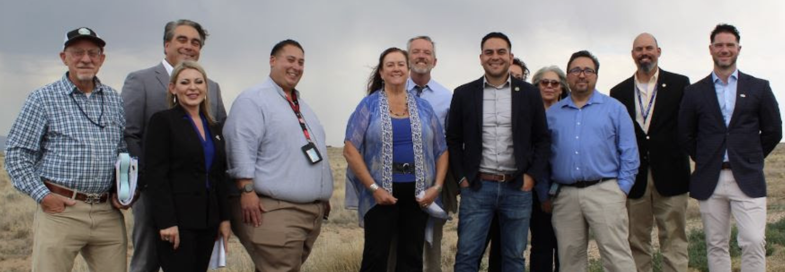
Vasquez Secured Funding for
Atrisco Vista Blvd Improvement Project
in Albuquerque
$4,000,000 for the reconstruction of a 2.35 mile stretch of
Atrisco Vista Boulevard to facilitate economic development that has the potential to bring 13,000 jobs to the area.

Slide 8
Vasquez also secured funding for:
Grant County I-10 Improvement Project in Grant Co.
$500,000 to re-pave nine miles of I-10 in SW N.M.
Wastewater Systems Improvement Project in Bayard
$959,752 to repair and replace broken and outdated equipment for residents of the City of Bayard and surrounding communities.
Double Eagle Waterline Replacement Proj. in Carlsbad
$959,752 to replace the existing water lines in the Double Eagle well field in Carlsbad that is losing
12 million gallons of water per year.

Slide 9
Vasquez also secured funding for:
Wastewater Improvement Project in Columbus
$500,000to improve a wastewater treatment facility.
Gila Community Ctr Improvement Project in Silver City
$400,000 for the construction of a new community center in Gila, a rural town.
Hatch Food Pantry Project
$300,000 to construct a permanent food pantry in Hatch
Lordsburg Community Center in Lordsburg
$500,000 for the renovation of a community center originally constructed in the 1980s.

Slide 10
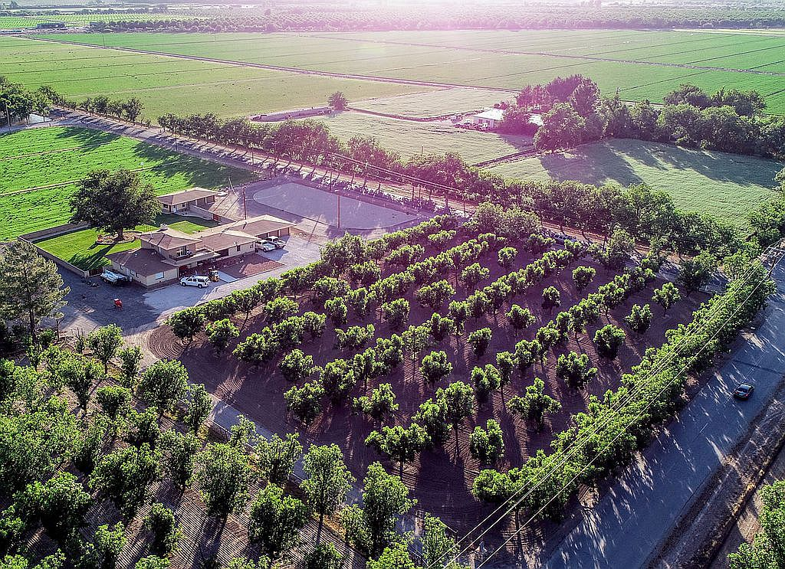
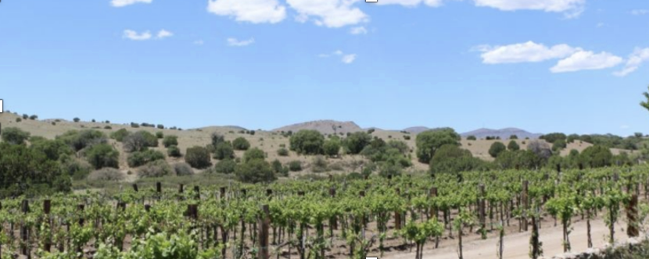
Vasquez awarded grants to these Rural Development projects
(Las Cruces) For technology to preserve locally grown fruits and vegetables for longer periods of time. ($125K)
4 A- Packing (L.C.): to use local chile in a new product ($250K)
New Mexico Wineries in
Lordsburg to build a solar
array that generates
enough energy to power
38 homes. ($100K)

Slide 11
Vasquez awarded grants to these Rural Development projects
To improve Anthony’s
sewer service ($5.5M)
for technical training and assistance to small rural businesses

Slide 12
Vasquez voted to fully fund lifeline programs such as
Supplemental Nutrition Access Program Assistance Program (SNAP)
Women, Infants and Children (WIC) food assistance program
to make sure families have food on the table

Slide 13
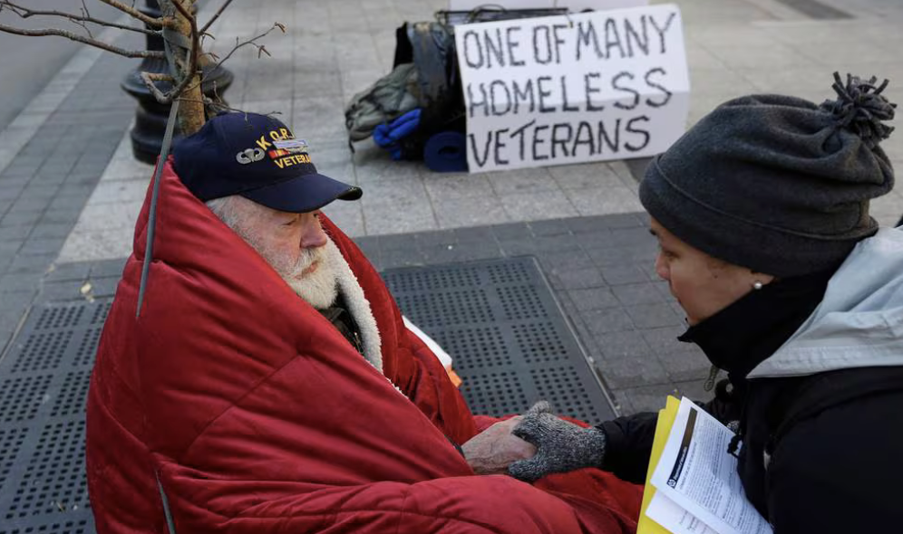
Vasquez also increased resources
to support homeless veterans and to provide them mental health care

Slide 14
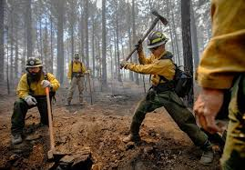
Vasquez also increased resources to
help firefighters avoid the pay cliff
so they can combat wildfires

Slide 15
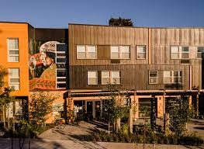
Vasquez also increased resources to
teachers at BIE schools
Native American housing
the Indian
Health Service

Slide 16
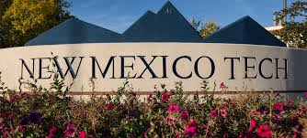
Vasquez secured funding for New Mexico Tech
Vasquez secured $41.4 million so New Mexico Tech can create three carbon storage sites in the San Juan Basin.
This funding will mean a cleaner and safer climate, and jobs.

Slide 17
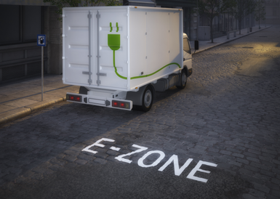
Vasquez Secured Funding for Lordsburg and Vado
$63 million to construct two commercial electric truck charging stations along I-10 in Vado and Lordsburg, bringing
Clean energy
Rural community development

Slide 18
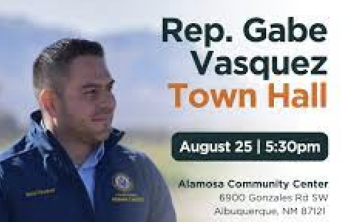
Rep. Vasquez provides Constituent Services & hosts Town Halls

Slide 19
Legislation

Slide 20
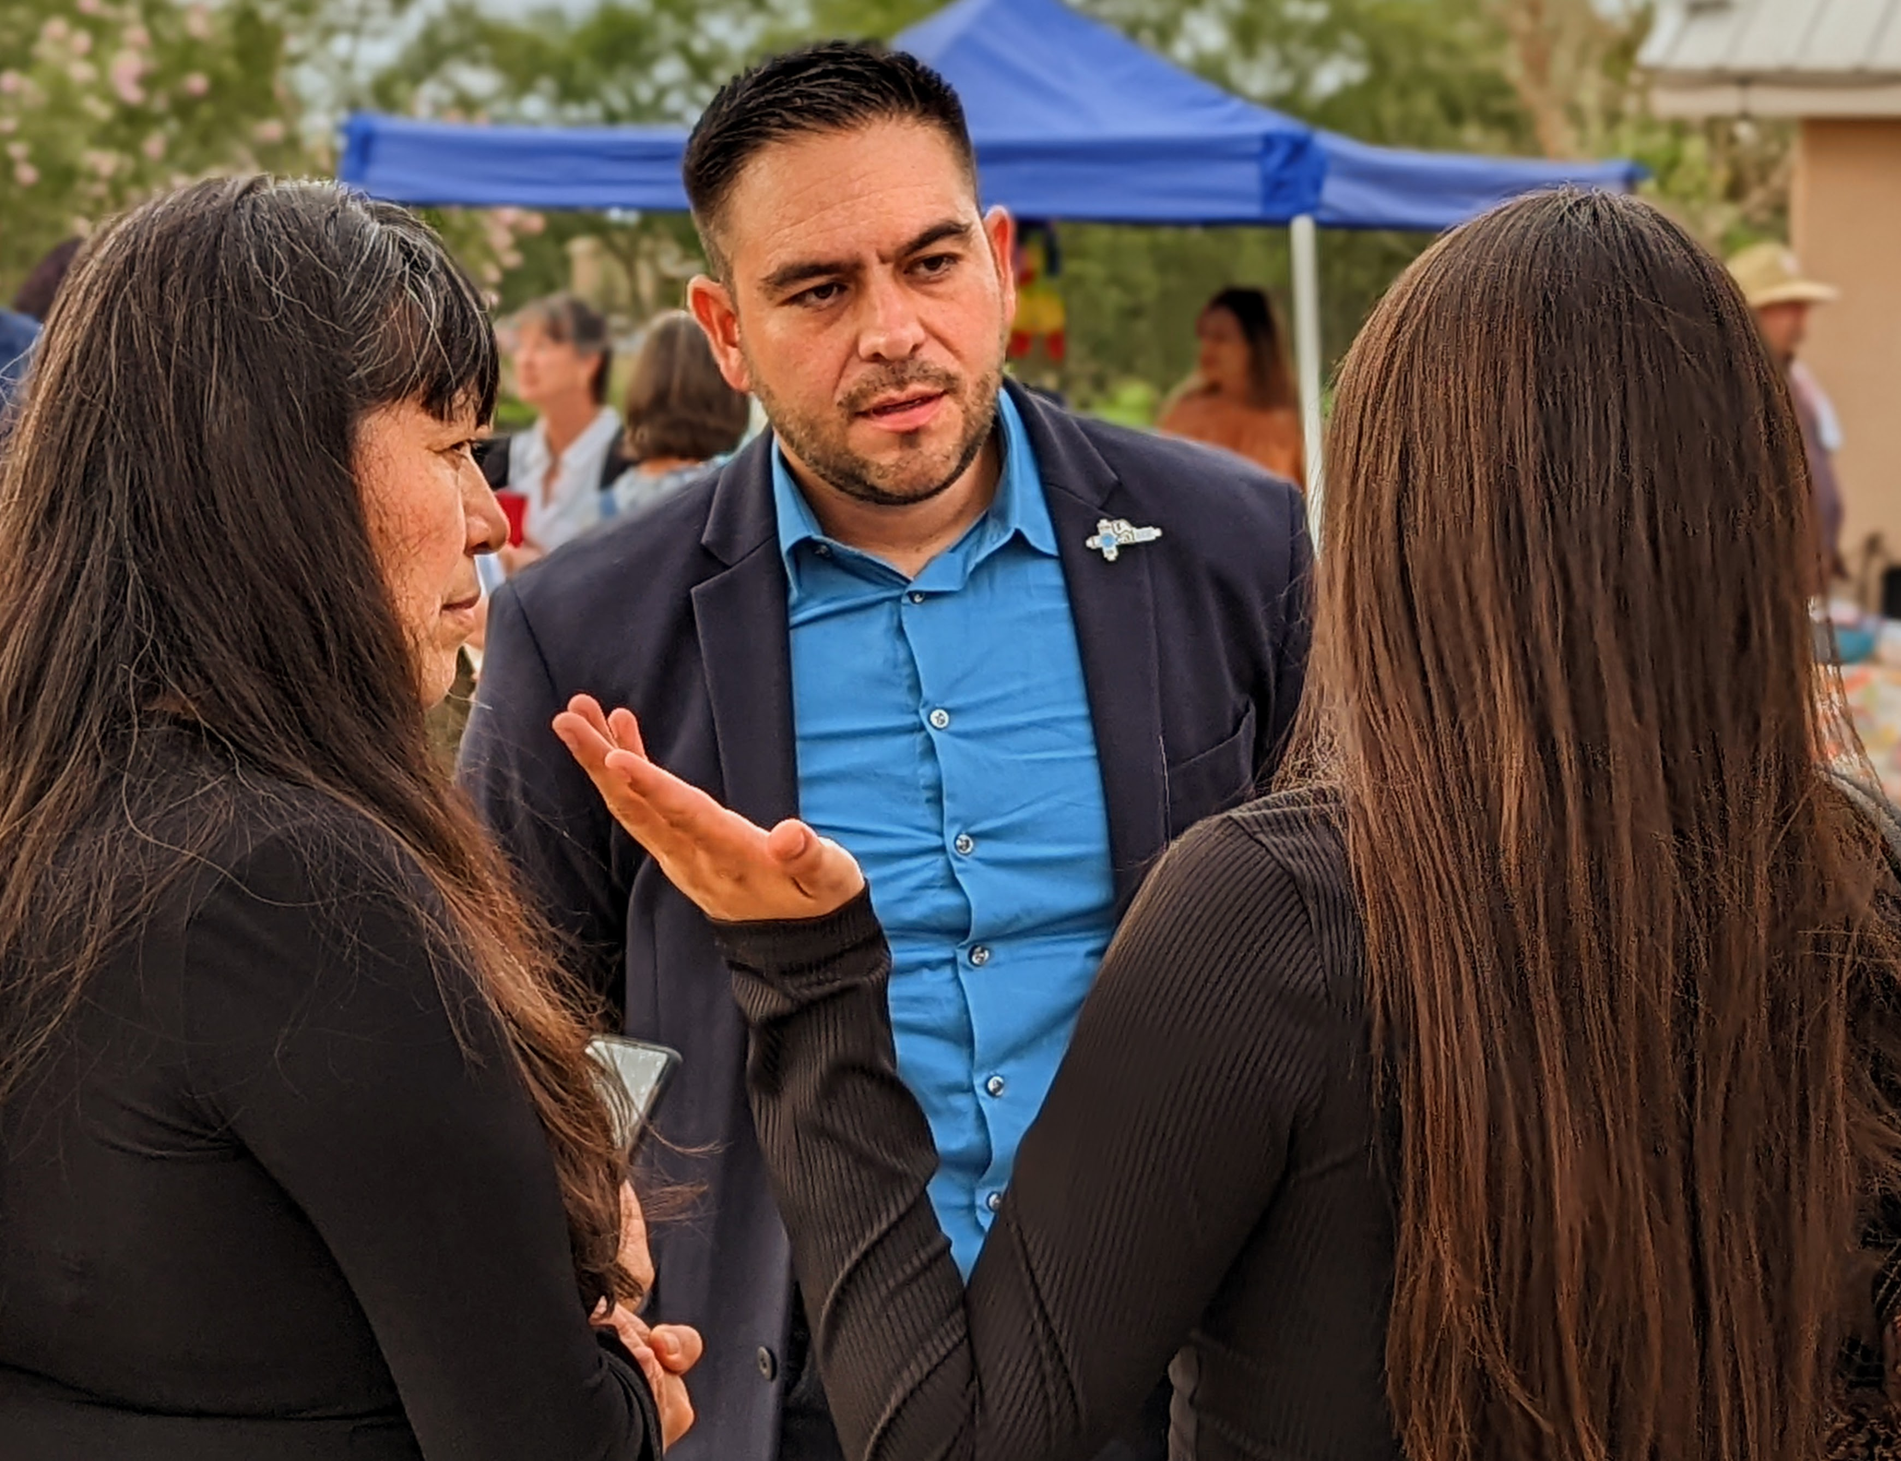
Rep. Vasquez votes to protect
Reproductive rights
LGBTQ rights
Voting rights
Social Security
Affordable Care Act
Lower costs

Slide 21
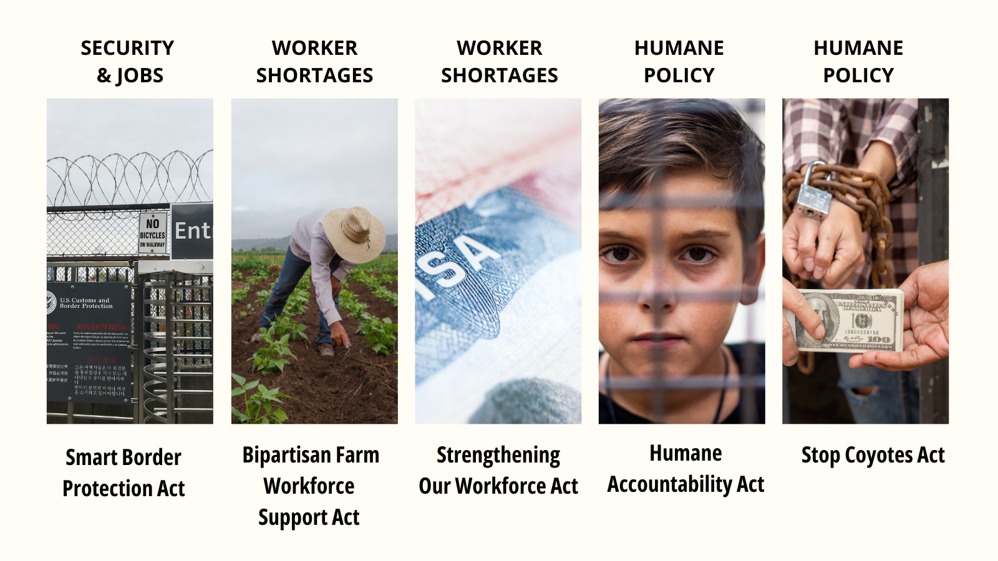
5 bills to create a common sense border policy

Slide 22
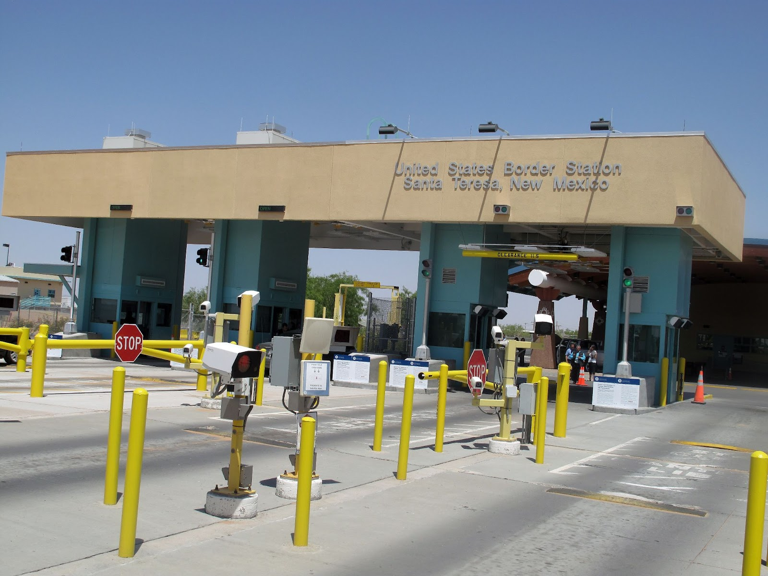
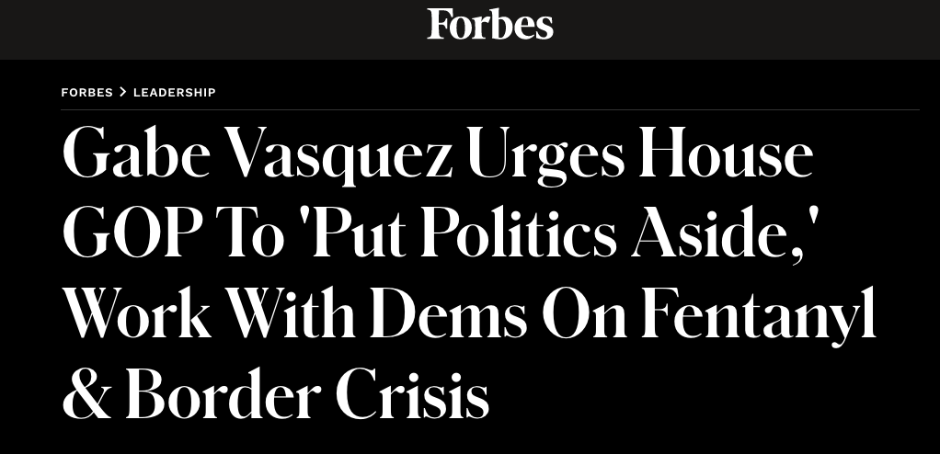
Joint Task Force to Combat Opioid Trafficking Act
This bipartisan bill authorizes the Dept. of Homeland Security to create a Joint Task Force to improve border security to prevent narcotics from being smuggled into the United States.
The Joint Task Force to Combat Opioid Trafficking Act

Slide 23
`. Energy Workers Health Improvement & Compensation Fund Act
Requires record profit-making
O&G executives to contribute to a fund to cover health care expenses for workers & their families for work-related illnesses
Ensures the well-being of NM’s energy workers while protecting NM’s long-term economic prospects.
Local energy workers and Somos Un Pueblo Unido partnered with Rep. Vasquez to create this fair compensation proposal.

Slide 24
Public Lands in Public Hands Act
bans the sale of most public lands
managed by the Dept. of the Interior and U.S. Forest service
bipartisan

Slide 25
Lower Costs Plan
Inflation
Relief Act
tax credit
Ranching
Without
Red Tape
fewer burdens on ranchers
Farm Workforce Support
Act
Combatting
Rural
Inflation
Act
+
+
+
plus votes to …
put doctors and nurses in rural communities
ensure families have affordable Internet
give tax credits to families with children

Slide 26
Economic Opportunity for Border Communities Act
In 2020, Santa Teresa Port & Industrial Parks created 6,000 jobs, had $1 billion output, and paid $26 million in taxes.
Vasquez bill would create a national strategy to increase the number of jobs in border communities, making them safe and prosperous
Endorsed by:

Slide 27
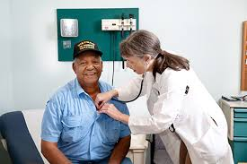
Veteran Medical Exams for Distant Areas
Ensures rural veterans can see certified health care providers for disability exams they need to get health care
bipartisan

Slide 28
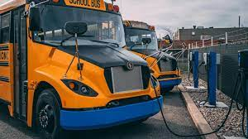
Community Facilities Program for Rural Clean School Bus Infrastructure
Charging technology for electric school buses in four NM communities (including Las Cruces)

Slide 29
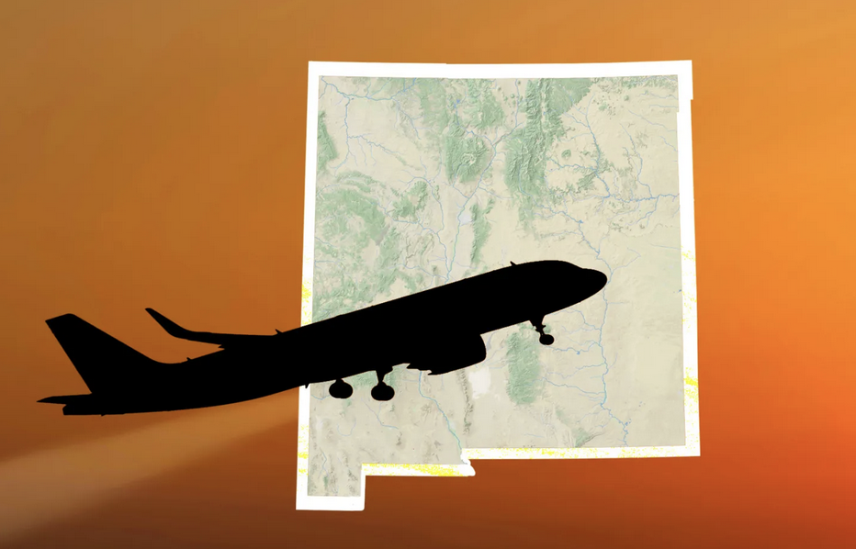
Expanding Regional Airports Act + Vasquez Amendment
FAA Reauthorization includes Vasquez Amendment:
which would study the
feasibility of reopening the Alamogordo-White Sands Airport
Vasquez supports rural economic development through regional airports:
Las Cruces to Albuquerque flight restored!

Slide 30
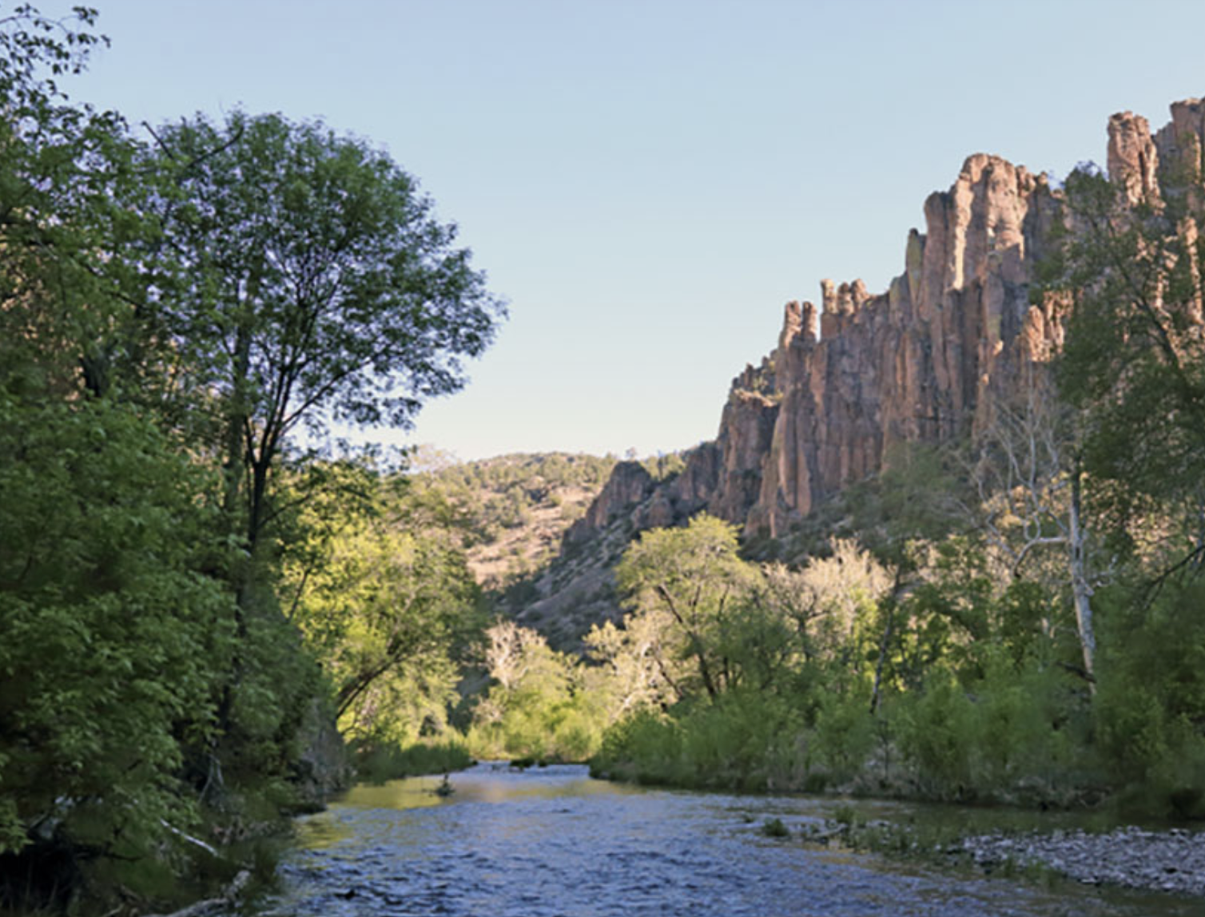
Greater Gila Wild and Scenic River Act
Vasquez introduced the House version of Sen. Heinrich’s bill to protect the Gila River and Wilderness.
The bill designates parts of the Gila as Wild and Scenic for recreational and agricultural economies that rely on it.

Slide 31
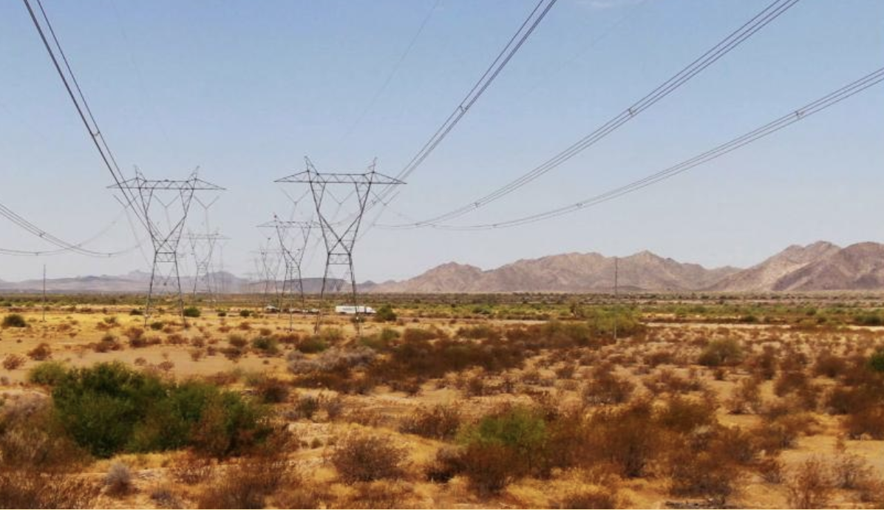
Vasquez protects the environment while serving his constituents
Vasquez provided
federal dollars for
workforce training
and infrastructure
for SunZia Wind &
Transmission for
renewable energy for
NM & Arizona
He partnered with the
Mescalero Apache tribe to protect Otero Mesa
He kept open the Grapevine Campground in the Gila Wilderness

Slide 32
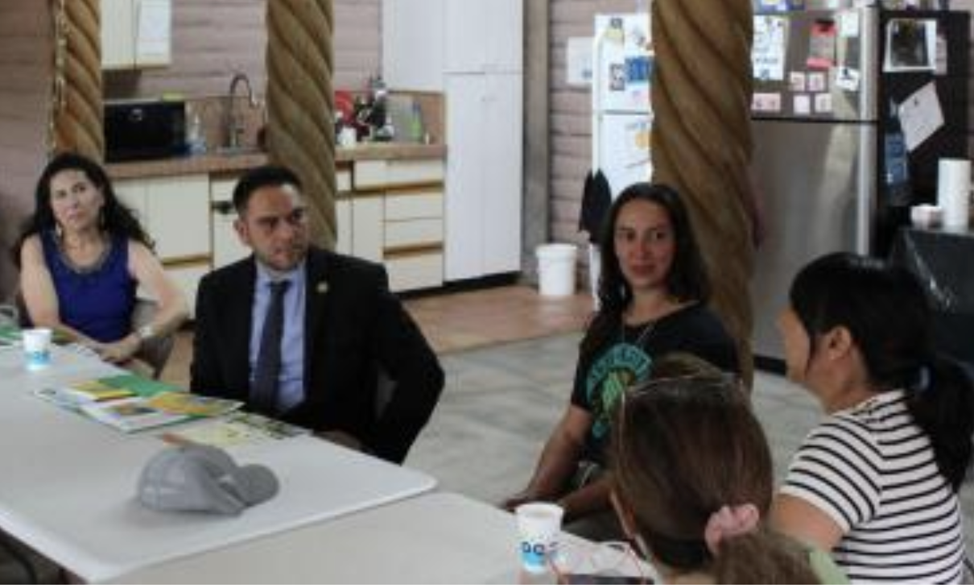
Vasquez continues to work on the Farm Bill
Serving on the Agriculture Committee, Rep. Vasquez meets with stakeholders to ensure the bill:
Provides for voluntary conservation to keep more of NM’s water in the ground
Promotes rural development such as farm worker housing
Gets arsenic and lead out of wastewater systems
Makes sure systems that help put food on the table have what they need.
Provides food security (SNAP, TEFAP, WIC).

Slide 33
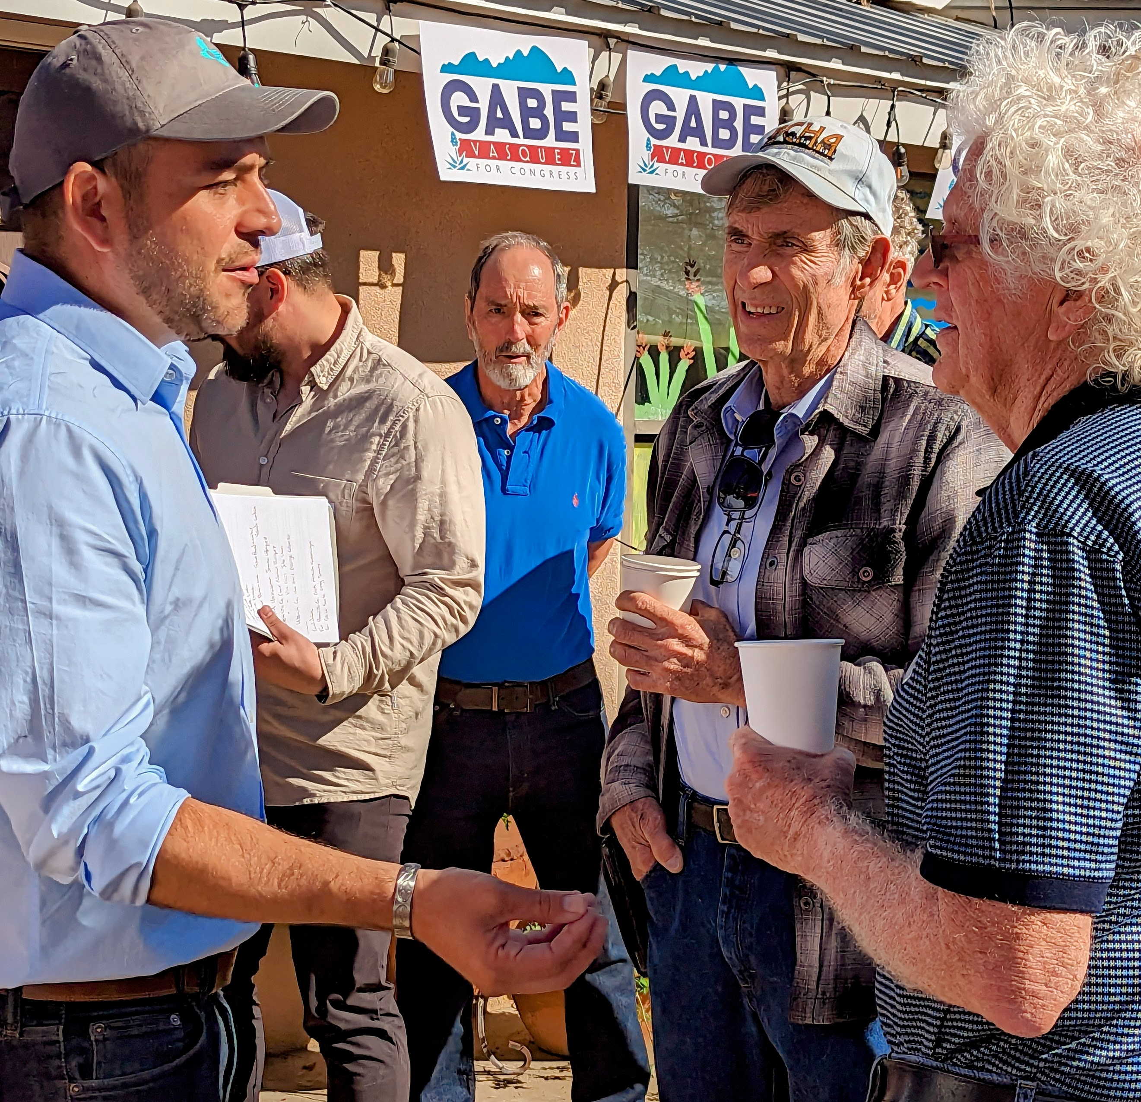
People over Politics
Rep. Gabe Vasquez puts people over politics to deliver for New Mexico

Slide 34
New Voices. New Voters. New Mexico.
Paid for by Blue CD2 New Mexico USA
and not authorized by any candidate or candidate’s committee.

